Slide 1

Python-HFSS API Week 03_ HFSS python库函数

Slide 2
Outline (目录)
函数库的导入
基本函数
函数库的扩展
2/15

Slide 3
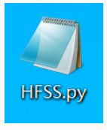
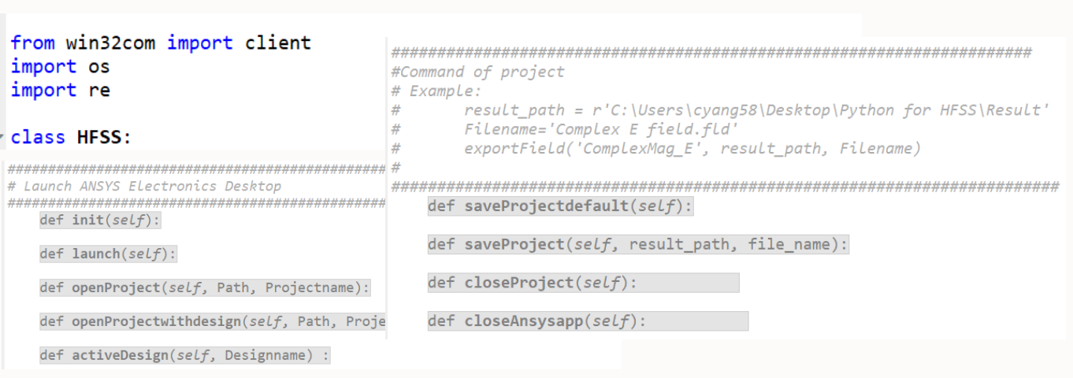
Optimizer Software
01
HFSS.py file
HFSS.py 为定义的HFSS python库函数
HFSS 内包含了一个名为HFSS的类（class）以及相关的HFSS 函数（functions）
3/15

Slide 4
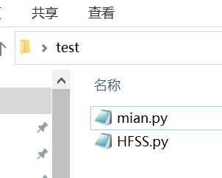
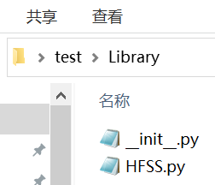
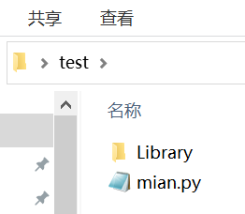
函数库的导入
01
Import HFSS.py
导入同级模块（在同一个文件夹中的.py文件）
main.py import HFSS.py 内的 class HFSS
from HFSS import HFSS
导入下级模块（在下级文件夹中的.py文件）
main.py import Library文件夹下 HFSS.py 内的 class HFSS
from Library.HFSS import HFSS
class HFSS instance （实例化）
h = HFSS()
3/15
https://zhuanlan.zhihu.com/p/64893308

Slide 5
基本函数
02
Connect Python with Ansys HFSS
Create a new .aedt file (new project and design)
h.launch()
Open an exist .aedt file (exist project and design)
h.openProject(hfss_file_dir, hfss_file_name)
h.openProjectwithdesign(hfss_file_dir, hfss_project_name, hfss_design_name)
Link to active .aedt file (opened project and design)
h.init()
Active another design in the same .aedt file (opened project and design)
h.activeDesign(hfss_design_name)
5/15

Slide 6
基本函数
02
02
Connect Python with Ansys HFSS
Create a new .aedt file (new project and design)
h.launch()
Open an exist .aedt file (exist project and design)
h.openProject(hfss_file_dir, hfss_file_name)
h.openProjectwithdesign(hfss_file_dir, hfss_project_name, hfss_design_name)
Link to active .aedt file (opened project and design)
h.init()
Active another design in the same .aedt file (opened project and design)
h.activeDesign(hfss_design_name)
5/15

Slide 7
基本函数
02
For Variables
Set new variables
h.setVariable(name, value, unit)
Example: h.setVariable('Period', 3, 'mm’); h.setVariable('Segenment', 6, ‘’); h.setVariable('Phase', 10, 'deg’); h.setVariable('Boundary_phase', '360/Segenment', 'deg’)
Change the variable value
h.setVariable(name, value, unit)
Example: h.changeVariablevalue('Period', ‘2.5', ‘mm’)
Get variables value from HFSS (return a string)
h.getVariablevalue(name)
Example: h.getVariablevalue('Period')
8/15

Slide 8
基本函数
02
基本函数
02
02
02
For Material
Add new material and change material…
Noted: Loss_tan is set as 2.4 GHz
h.addMaterial(name, DK, loss_tan)
h.addMaterial(object, material)
Example:
h.addMaterial('DK10', 10, 0.0032)
h.changeMaterial('Cylinder1', 'DK10')
5/15
5/15

Slide 9
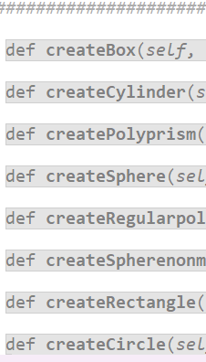
基本函数
02
02
For basic shape
Create box, Cylinder, Polyprism, Sphere, Regularpolyhedron, Rectangular, Circle…
Noted: Material: 'defined material'
Example:
h.createBox('0mm','0mm','0mm','10mm','20mm','30mm', 'DR', 'DK10’)
h.createCylinder('0mm','0mm','0mm','3mm','3mm','Z','Cylinder1','vacuum') h.createRegularpolyhedron('0mm','0mm','0mm','3mm','3mm','0mm','300mm',7,'Z','Cylinder10','vacuum’)
5/15

Slide 10
基本函数
02
基本函数
02
02
02
For Basic model operation
Basic model operation… copy, unite, subtract, insert, connect, move, rotate, mirror, duplicate move, duplicate rotate, duplicate mirror
Example:
h.copy('Cylinder1’); h.connect( 'Cylinder1','Cylinder2’);
h.unitef('Cylinder1','Cylinder2’); h.unitet('Cylinder1','Cylinder2’);
h.subtractf('Cylinder1','Cylinder2'); h. subtractt('Cylinder1','Cylinder2’);
h.intersectf('Cylinder1','Cylinder2’); h. intersectt('Cylinder1','Cylinder2’);
h.rotate('Cylinder1','Z','30deg’); h.move('Cylinder1','10mm','30mm','20mm’,); h.mirror('Cylinder1','10mm','30mm','20mm','0mm','1mm','0mm’)
h.duplicateRotate('Cylinder1','Z','30deg',3)
h.duplicateMove('Cylinder1','10mm','0mm','0mm',6)
h.duplicateMirror('Cylinder1','0mm','0mm','0mm','0mm','0mm','1mm')
5/15
5/15

Slide 11
基本函数
02
基本函数
02
02
02
For analysis setup
Set an analysis setup
h.insertSetup(Setupname,Centerfreuency)
Example: h.insertSetup('Setup1', '3.5GHz’)
Set a Sweep analysis (Sweep_type: ‘Discrete’ ‘Fast’ ‘Interpolating’ )
h.insertFrequencysweep(Setupname, Minfrequency, Maxfrequency, Step, Sweep_type)
Example: insertFrequencysweep('Setup1', '6GHz', '20GHz', '100MHz', 'Fast')
Solve an analysis setup
h.solve(Setupname)
Example: h.solve('Setup1')
5/15
5/15

Slide 12
基本函数
02
基本函数
02
02
02
For project
Save the .aedt file
h.saveProject(result_path, file_name)
Example: h. saveProject(r'C:\Users\cyang58\Desktop\Python for HFSS\Result', ‘Hfssproject1’)
Close the current project
h.closeProject()
Example: h.closeProject()
5/15
5/15

Slide 13
基本函数
02
基本函数
02
02
02
For model view
h.fitAll( ) Example: h.fitAll()
Get face ID for assign port
h.getFacebyposition(Object, Xposition, Yposition, Zposition)
Example: h.getFacebyposition('Port','Monopole_position','0mm','-Feed_height')
Assign Excitation: Wave port, Floquet port, Lumped port
h.assignWaveport(FaceID, Startx, Starty, Startz, Endx, Endy, Endz)
Example: h.assignWaveport(face_id,Monopole_po,'0mm',’'+Feed_he,Monopole_po,'3mm','-'+Feed_he)
Create air box (region) and Set region as radiation boundary
h.createRegion(Var_region) h.assignRadiationRegion( )
Example: h.createRegion('40mm’) h.assignRadiationRegion()
5/15
5/15

Slide 14
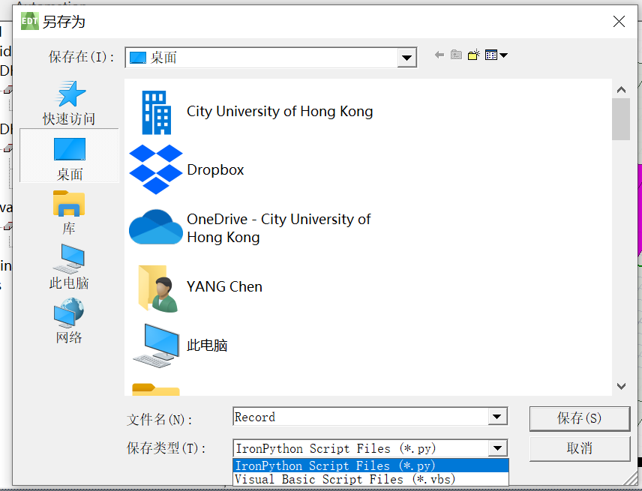
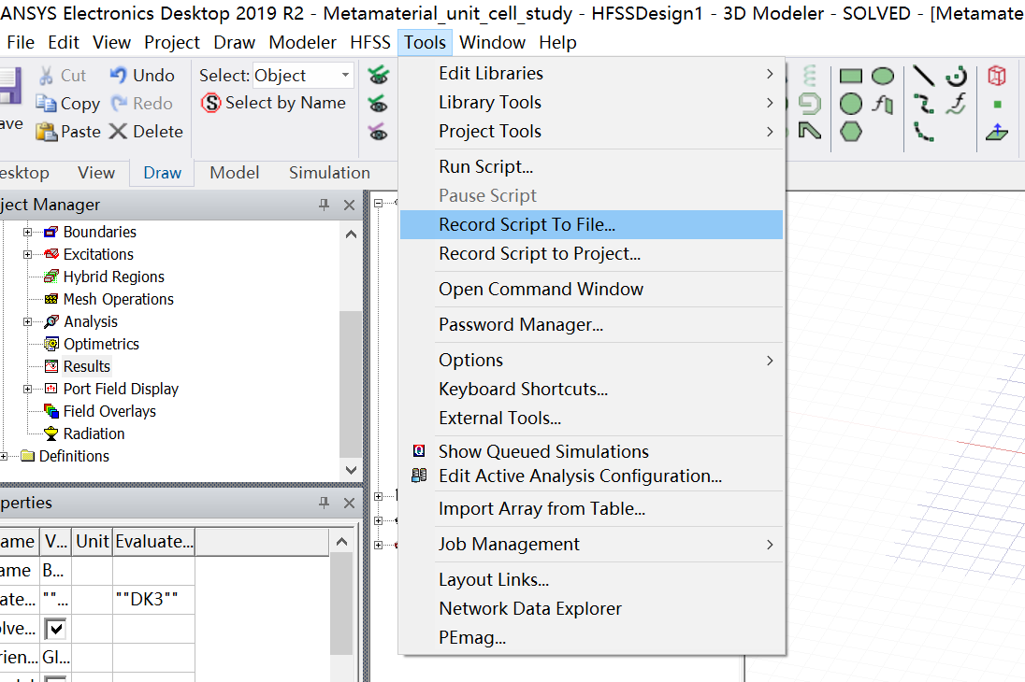
库函数的扩展
03
Add new function for HFSS.py
HFSS支持脚本控制，可将操作录制为一段脚本，便于自动化运行以及实现较为复杂的建模功能，该功能位于Tools——Record Script File中，支持vbs和python两种格式 (这里我们统一使用python)
8/15

Slide 15

库函数的扩展
03
Record.py
import ScriptEnv
ScriptEnv.Initialize("Ansoft.ElectronicsDesktop")
oDesktop.RestoreWindow()
oProject =oDesktop.SetActiveProject("Metamaterial_unit_cell_study")
oDesign = oProject.SetActiveDesign("HFSSDesign1")
oDesign.ChangeProperty(
[ "NAME:AllTabs",
[ "NAME:LocalVariableTab",
["NAME:PropServers",
"LocalVariables"],
["NAME:NewProps",
[ "NAME:Start",
"PropType:=" , "VariableProp",
"UserDef:=" , True,
"Value:=" , "2021mm"
]
]
]
])
Example: Set a variable named ‘Start’
with value of ‘2021 mm’
8/15

Slide 16
库函数的扩展
03
From Record.py to Function in HFSS.py
def setVariable(self, Var_name, Var_value, unit):
Self.oDesign.ChangeProperty(
[ "NAME:AllTabs",
[ "NAME:LocalVariableTab",
["NAME:PropServers",
"LocalVariables"],
["NAME:NewProps",
[ "NAME:" + Var_name,
"PropType:=" , "VariableProp",
"UserDef:=" , True,
"Value:=" , str(Var_value)+' '+ unit ]
]
]
])
oDesign.ChangeProperty(
[ "NAME:AllTabs",
[ "NAME:LocalVariableTab",
["NAME:PropServers",
"LocalVariables"],
["NAME:NewProps",
[ "NAME:Start",
"PropType:=" , "VariableProp",
"UserDef:=" , True,
"Value:=" , "2021mm"
]
]
]
])
h.setVariable(name, value, unit)
Example: h.setVariable('Period', 3, 'mm’);
8/15

Slide 17

This program is writing for Ansys HFSS software. It possesses three parts including the basic software operations, advanced data post-process, and optimization algorithms. Maybe it will also have some GUI design and others.
This is the first part ---Class HFSS, which mainly includes the basic software operations. To make it easier to use these functions, there are examples for each function.
Hope you will have a pleasant experience!
The program starts from 18th NOV. 2020 at City University of HK. Here we have a group of partners (Chen Yang, Ting Li, Zhiyi Zhang, and Zhili Su) with the guidance of Dr. Lu Kai, Hope we can complete this huge project. Best regards to us. If you have any questions, please email to Chen.Yang@my.cityu.edu.hk
Created on Wed Nov 18 21:36:11 2020

